Slide 1
Hybrid epithelial/mesenchymal cells on the archetype geometry of breast cancer
First Degree Thesis · Mid-semester presentation
Are hybrid E/M cells the generalists inside a task trade-off simplex?
Vedashree Mahajan · ID f20220216 · BITS Pilani, K K Birla Goa Campus
Supervisor: Dr. Mohit Kumar Jolly, Department of Bioengineering, IISc · Period: 10 Aug – 4 Oct 2026

Slide 2

Flow of the work
1
2
3
4
5
The idea
Method check
Transcriptome
KS genes and host swap
Hybrid test
Specialists sit at vertices, generalists inside. Are hybrid E/M cells the generalists?
Rebuild Pareto Task Inference and reproduce SCLC (Groves 2022).
Breast (63 lines) and GBM (54 lines): no significant simplex.
Hybrid cells are not the interior class. One patient dominates the hybrid corner.
206 KS genes give a triangle. A tumor-fit triangle holds cell lines, not the reverse.
Next
Refit the Pal triangle without patient TN-0135, then write the thesis around the host swap and the hybrid test.
Mahajan · Hybrid E/M cells on the archetype geometry of breast cancer · 2

Slide 3
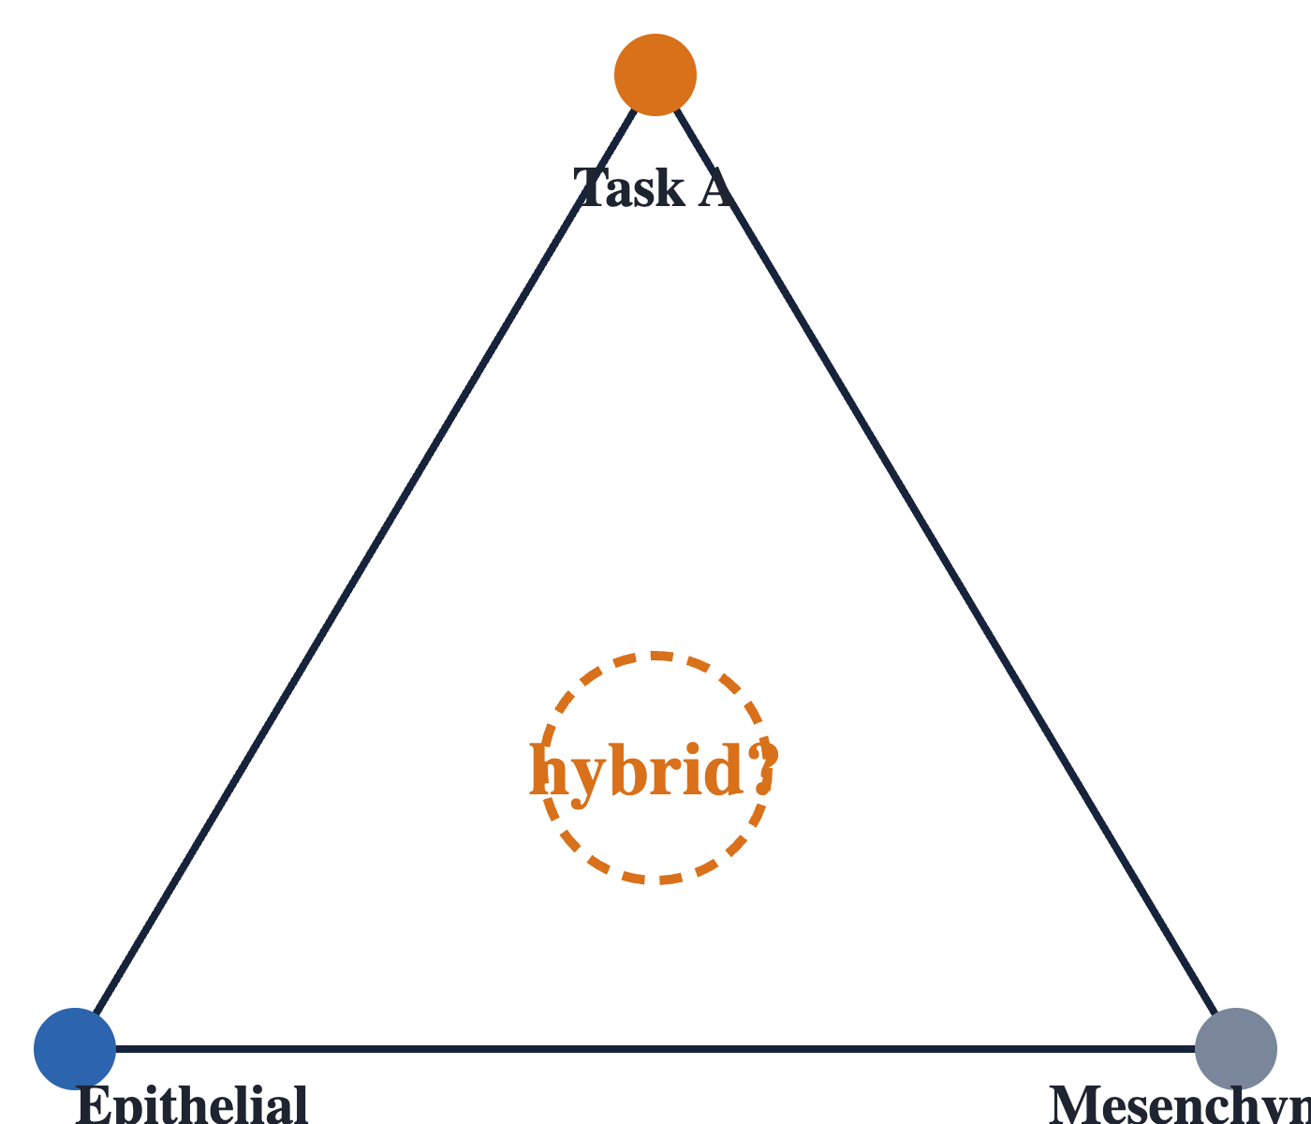
The question
Task trade-off
Hausser 2019: tumors lie near a low-dimensional polytope. Specialists sit at vertices, generalists in the interior.
Proof in SCLC
Groves 2022: SCLC cell lines form a five-vertex simplex and tumors occupy it.
Hypothesis set at the start
Extreme epithelial and mesenchymal cells sit at vertices. Plastic hybrid E/M cells sit in the interior.
Mahajan · Hybrid E/M cells on the archetype geometry of breast cancer · 3

Slide 4
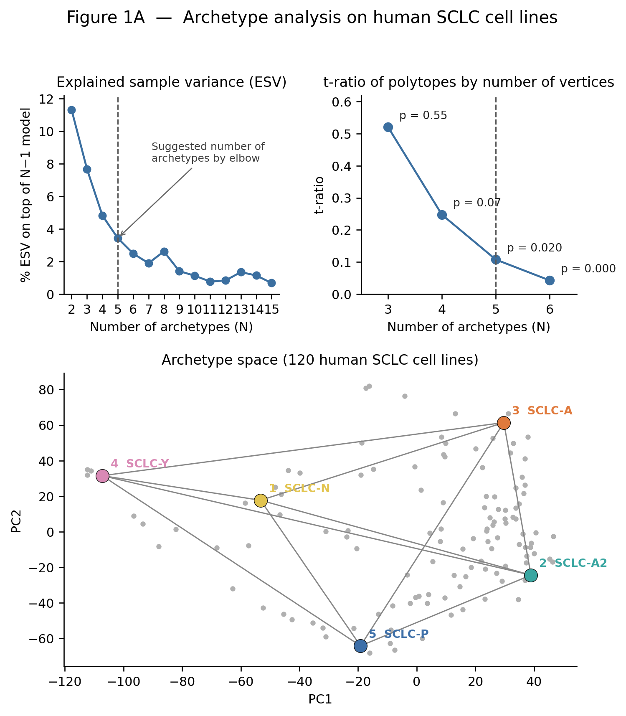
Method check: Groves SCLC reproduced
Quantity | This work | Groves 2022
t-ratio at k = 5 | 0.107 | 0.107
Smallest significant k (1,000 shuffles) | 5 | 5
PCA, principal convex hull analysis, a permutation-tested volume ratio, and projection into a frozen simplex. After this, a new dataset can give a biological result rather than a coding one.
Mahajan · Hybrid E/M cells on the archetype geometry of breast cancer · 4

Slide 5
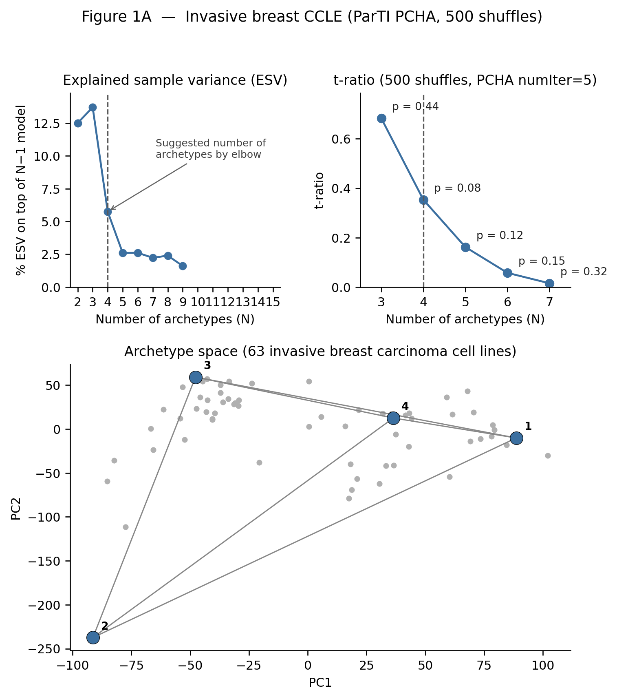
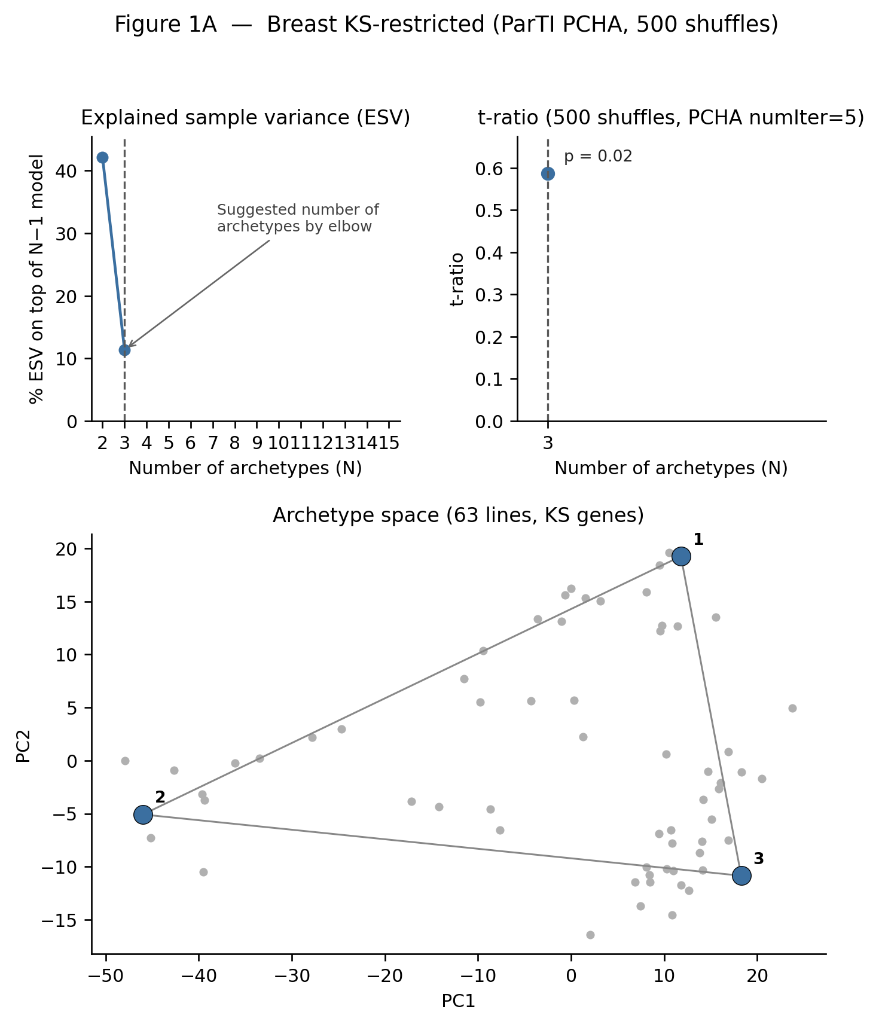
Transcriptome: no simplex. KS genes: a triangle
Full transcriptome
63 breast lines: best p = 0.082. GBM, 54 lines: no significant k. The method can say no.
206 KS genes
Same 63 lines: triangle with t-ratio 0.587, p = 0.022 (500 shuffles). HER2 gets no vertex.
Left: full breast transcriptome. Middle: KS-restricted. The first positive result is still a cell-line result.
Mahajan · Hybrid E/M cells on the archetype geometry of breast cancer · 5

Slide 6
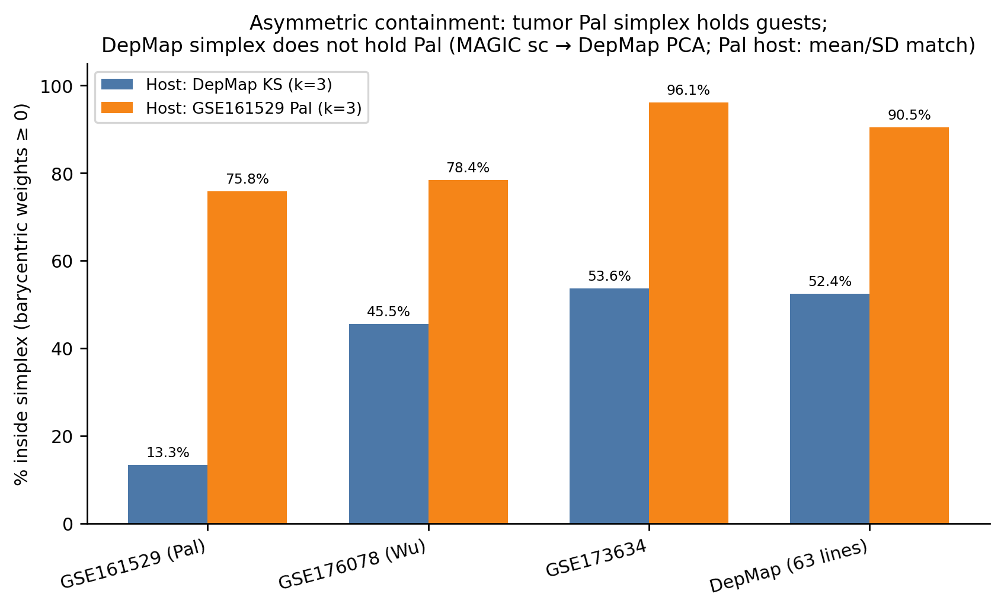
Host swap: a tumor triangle holds cell lines
Dataset | n | Cell-line triangle | Pal triangle
Pal tumor cells | 84,602 | 13.3% | 75.8%
Wu tumor cells | 24,162 | 45.5% | 78.4%
GSE173634 cells | 35,271 | 53.6% | 96.1%
DepMap lines | 63 | 52.4% | 90.5%
Cell lines are a truncated tumor geometry: they cover the epithelial side and under-represent the mesenchymal extreme. Fraction of samples inside each k = 3 triangle.
Mahajan · Hybrid E/M cells on the archetype geometry of breast cancer · 6

Slide 7
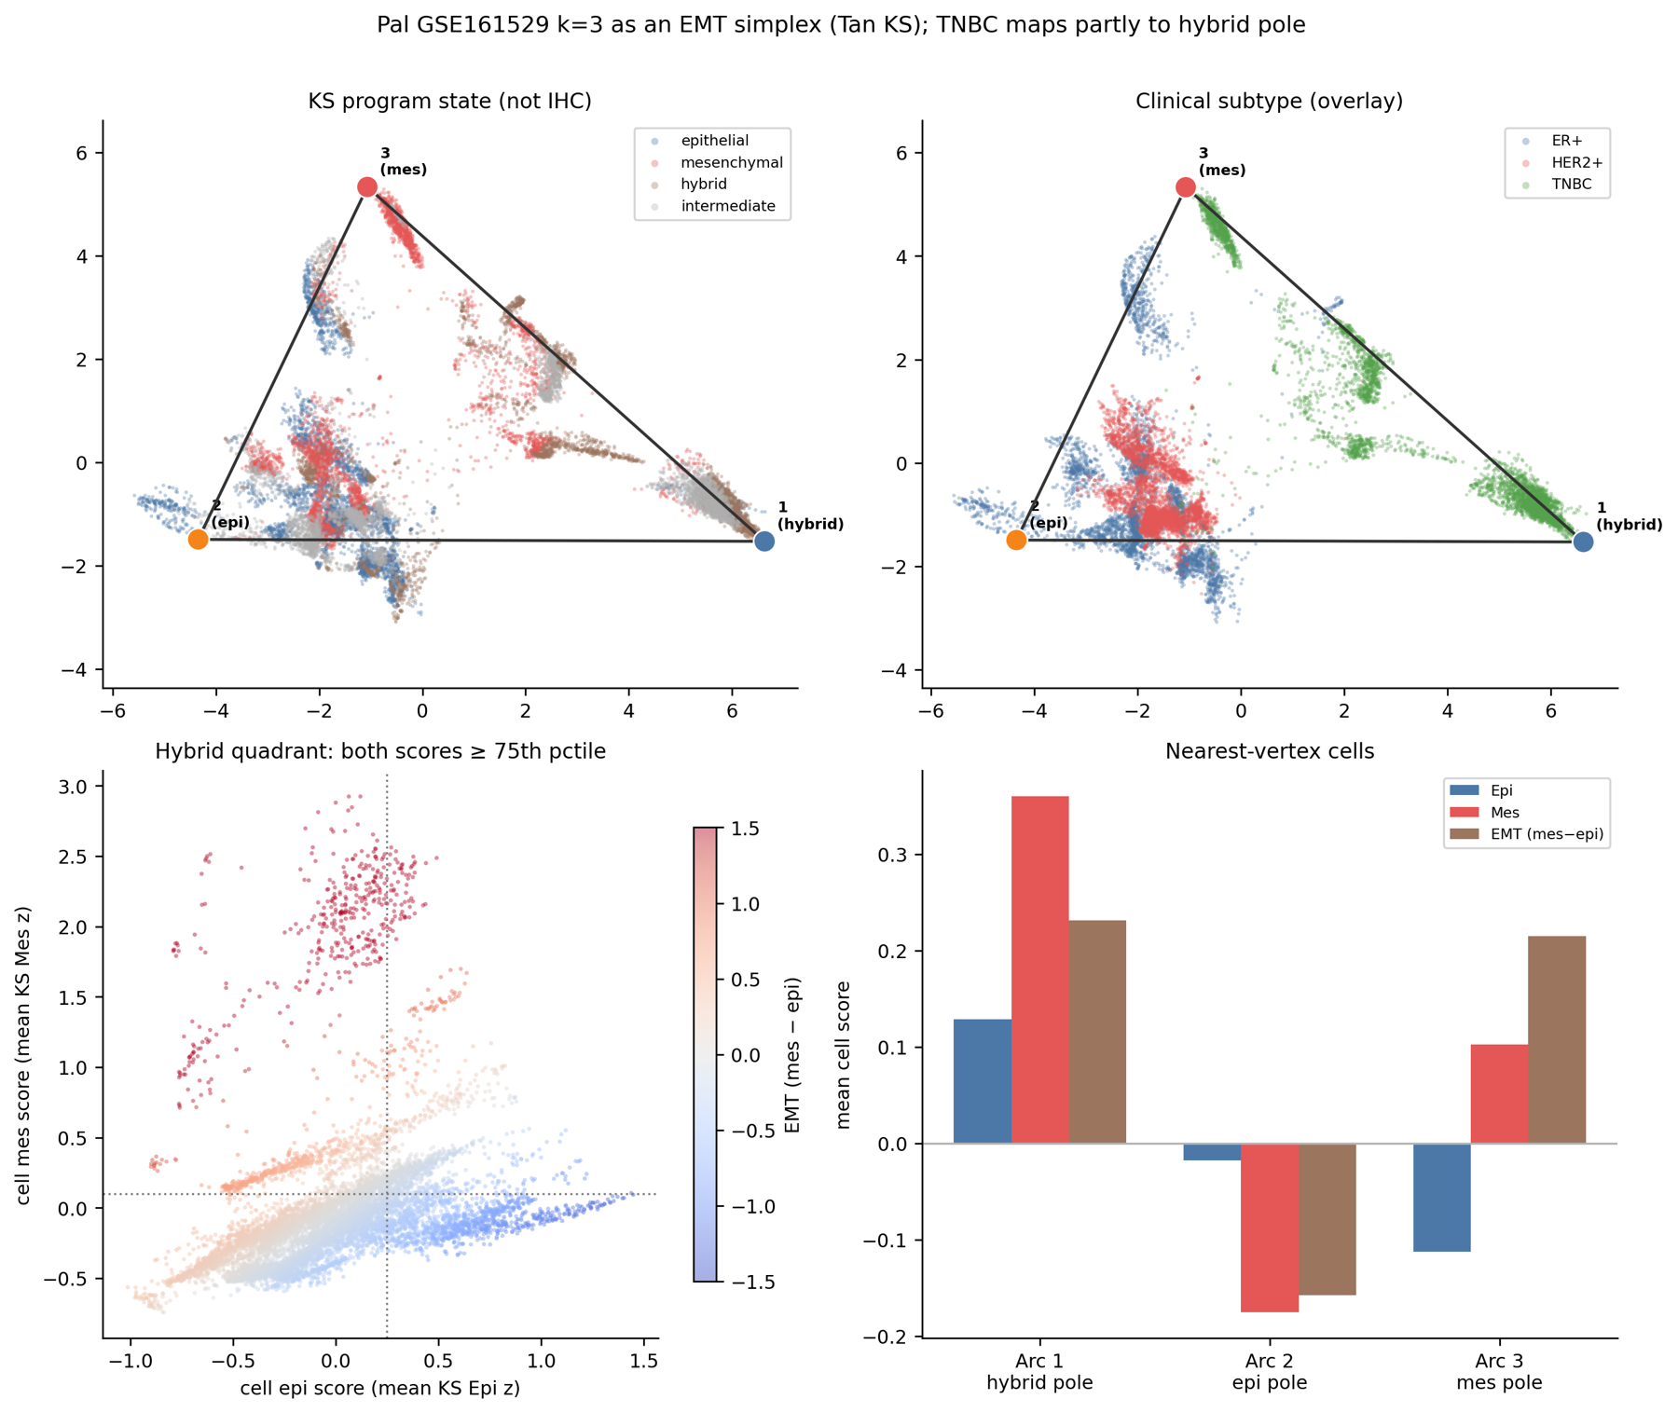
The corners are programs, not clinical subtypes
Arc 2: epithelial
Luminal program. Holds ER+ and HER2+ cells.
Arc 3: mesenchymal
VIM program. Not one IHC class.
Arc 1: TNBC-enriched
Dominated by one patient, TN-0135. TNBC splits across Arc 1 and Arc 3.
Pal GSE161529, k = 3 (t-ratio 0.66, beats 50 of 50 permutations, p < 0.02). Figure labels Arc 1 as the hybrid pole; see the patient audit.
Mahajan · Hybrid E/M cells on the archetype geometry of breast cancer · 7

Slide 8
Hybrid test: where do hybrid cells sit?
Hybrid (gene score)
Specialist (geometry)
Both KS epithelial and mesenchymal scores in the top quartile of its own dataset.
Largest archetype weight beats the second by at least 0.35. Everything else is interior.
Dataset | Hybrid samples | At a corner | Interior | Median weights (Arc 1, 2, 3)
Pal | 8,719 (10.3%) | 65.6% | 34.4% | 0.68, 0.02, 0.11
Wu | 2,413 (10.0%) | 6.3% | 93.7% | 0.51, 0.11, 0.38
GSE173634 | 65 (0.2%) | 0% | 100% | 0.36, 0.28, 0.37
DepMap | 0 | — | — | no jointly high line
Mahajan · Hybrid E/M cells on the archetype geometry of breast cancer · 8

Slide 9
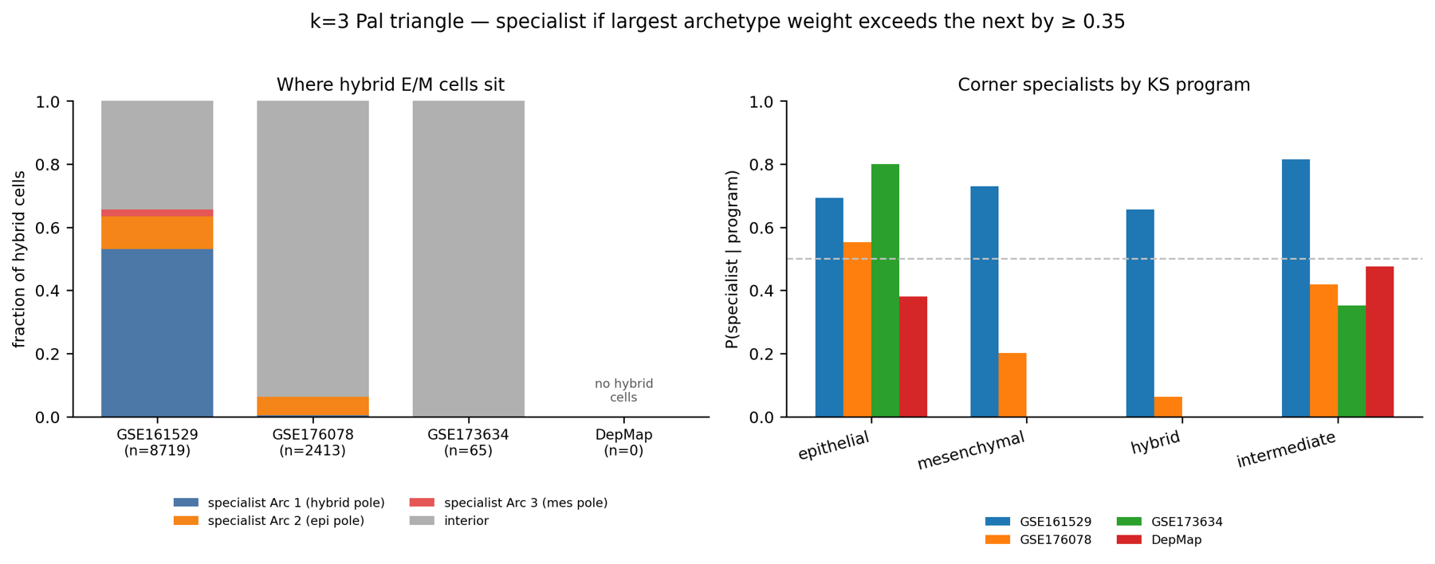
Hybrid cells are not the generalists
Hybrid is only 13–15% of interior cells in the two tumor atlases. Epithelial samples are the ones that reliably reach a corner. Mesenchymal samples are interior in Wu, GSE173634 and DepMap.
Mahajan · Hybrid E/M cells on the archetype geometry of breast cancer · 9

Slide 10
Patient audit: one patient behind each hybrid signal
92%
~50%
65
0
of Pal hybrid cells at Arc 1 are TN-0135 (14,322 cells, median weights 0.91, 0.00, 0.08)
of Wu hybrid cells are CID4515. It never reaches a corner (specialist rate 0%)
hybrid cells in GSE173634, all from line CAL851, at the centroid
hybrid DepMap lines. All 21 mesenchymal lines are interior
An apparent hybrid vertex should not be reported as a third task until the dominant patient is removed and the fit repeated.
Mahajan · Hybrid E/M cells on the archetype geometry of breast cancer · 10

Slide 11
Conclusions and limits
What the data support
Limits
Cell lines are the wrong host for the corners of the KS simplex.
The reproducible specialist is the epithelial program.
Hybrid E/M is not the interior generalist: a patient-dominated vertex, an edge, or absent.
Pal permutation test used 50 shuffles.
Hybrid call is a within-dataset rank; the 0.35 cut is a choice.
MAGIC imputation, one signature, one disease.
Mahajan · Hybrid E/M cells on the archetype geometry of breast cancer · 11

Slide 12
Next steps: finish and extend the analysis
OCTOBER
NOVEMBER
EXTENSIONS
Close the key check
Harden the hybrid call
Take the result further
Refit Pal k = 3 without TN-0135
Reproject Wu, GSE173634 and DepMap
Three outcomes, each reportable
Purity versus EMT score, with the 0.35 cut as a sensitivity table
One common-scale hybrid call across all four datasets
Leave each large patient out in turn, to test whether any corner is stable
Repeat the host swap with a second EMT signature
Link corner weights to survival and drug response, only once the refit is in
9 Oct
15 Nov
20 Nov
28 Nov
10–15 Dec
Midsem report
Viva II
Thesis draft
Final report
Final viva
Mahajan · Hybrid E/M cells on the archetype geometry of breast cancer · 12

Slide 13
Beyond RNA: methylome and proteome
Use the archetype weights as the common coordinate, then ask whether other molecular layers agree with the RNA-defined corners.
Layer | Candidate data | Question | First test
Methylome | DepMap/CCLE methylation for the 63 breast lines; TCGA-BRCA tumors | Do the epithelial and mesenchymal corners differ in methylation at CDH1, VIM, ZEB1 and miR-200 loci? Is the hybrid state epigenetically distinct? | Regress methylation on archetype weights in the 63 lines
Proteome | DepMap/CCLE proteomics; CPTAC breast tumors | Do E-cadherin and vimentin levels agree with the RNA corners? Does the cell-line truncation also hold at the protein level? | Same 63 lines, then project CPTAC tumors into the frozen Pal triangle
Cell lines first, since no new cohort is needed. Tumors second.
After the leave-one-patient result. Dataset availability and sample matching still to be confirmed.
Mahajan · Hybrid E/M cells on the archetype geometry of breast cancer · 13

